Slide 1
Irony
3 Kinds of Irony

Slide 2
What is Irony?
Irony is about expectations.
Irony: a difference between what is expected to happen and what actually happens
3 kinds of irony:
Verbal
Dramatic
Situational

Slide 3
Verbal Irony
A character says one thing but means the opposite.
Also called sarcasm or being sarcastic.
Examples
The locker room smells really good.
Awesome! Another homework packet!

Slide 4
Verbal Irony

Slide 5
Dramatic Irony
When the reader understands more about the events of a story than a character.
You know something that a character doesn’t.
Example
Tim’s parents are proud of the “A” he got on the test, but we know he cheated.
Alex writes a love poem to Judy, but we know that Judy loves Devin.

Slide 6
Dramatic Irony

Slide 7
Situational Irony
When what actually happens is the opposite of what is expected.
Something about the situation is completely unexpected.
Example
A police station gets robbed.
Bill Gates uses an Apple computer.

Slide 8
Situational Irony

Slide 9
What’s the Irony?
1. George breaks a date with his girlfriend, so he can go to a ball game with the guys. At the concession stand, he runs into his girlfriend with another guy.
Verbal Dramatic Situational

Slide 10
What’s the Irony?
1. George breaks a date with his girlfriend, so he can go to a ball game with the guys. At the concession stand, he runs into his girlfriend with another guy.
Verbal Dramatic Situational
We don’t expect George to see his girlfriend with another guy.

Slide 11
What’s the Irony?
1. You are watching a horror movie. You know that the evil monster is waiting for the main character in the closet, but the character doesn’t know and opens the closet door…
Verbal Dramatic Situational

Slide 12
What’s the Irony?
1. You are watching a horror movie. You know that the evil monster is waiting for the main character in the closet, but the character doesn’t know and opens the closet door…
Verbal Dramatic Situational
You, as the audience, know something that the main character doesn’t.

Slide 13
What’s the Irony?
1. As you walk outside into the pouring rain with large chunks of hail, your friend looks over at you, rolls her eyes, and say, “What lovely weather we’re having today.”
Verbal Dramatic Situational

Slide 14
What’s the Irony?
1. As you walk outside into the pouring rain with large chunks of hail, your friend looks over at you, rolls her eyes, and say, “What lovely weather we’re having today.”
Verbal Dramatic Situational
Your friend is saying that it is lovely weather, but what she means is just the opposite. It is a very dreary day.

Slide 15
Review
Something that is ironic is unexpected.
If unexpected by a character, it’s dramatic.
If unexpected by everyone, it’s situational.
If it’s sarcasm, it’s verbal.

Slide 16
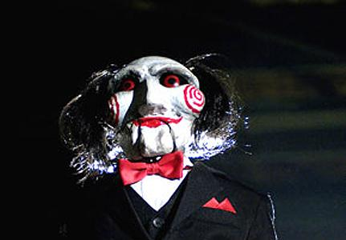
Let’s play a game…
In a group, try to determine what type of irony is mentioned.
Write it on your board and hold it up when you’re done.

Slide 17
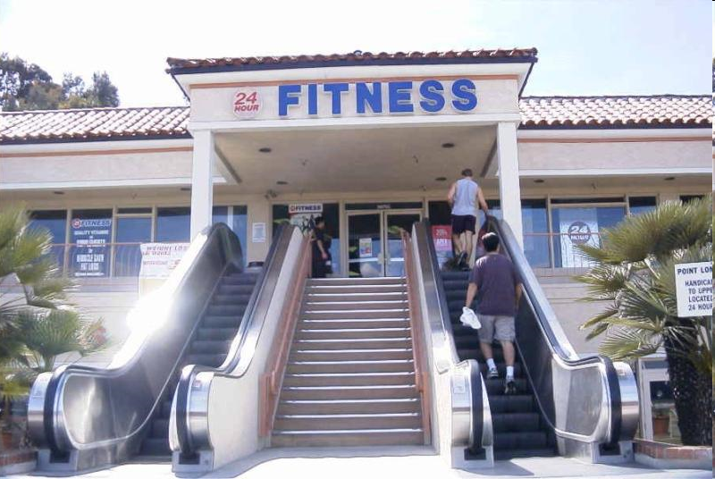
Let’s play a game…
Notes:
Situational- You don’t expect a fitness center to have an escalator-those don’t burn as many calories!
17

Slide 18
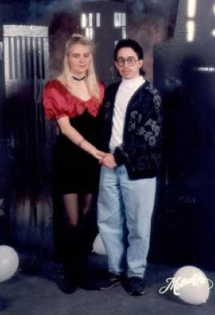
Let’s play a game…
Your date for the school dance shows up in ripped jeans and a stained t-shirt. With a smirk, you say, “Oh! I see you dressed up for the occasion!”
Notes:
Verbal-What you’ve said is different than what you mean. You mean that your date hasn’t bothered to dress up at all, but that isn’t what you said.
18

Slide 19
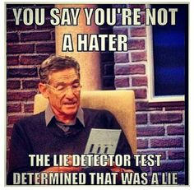
Let’s play a game…
When watching a talk show, the audience knows why a person has been brought on the show. However, the person in the chair doesn’t know that they are going to be reunited with a long lost friend.
Notes:
Dramatic-The audience knows information that the character doesn’t (We know why the person has been brought on the show, but they don’t.).
19

Slide 20
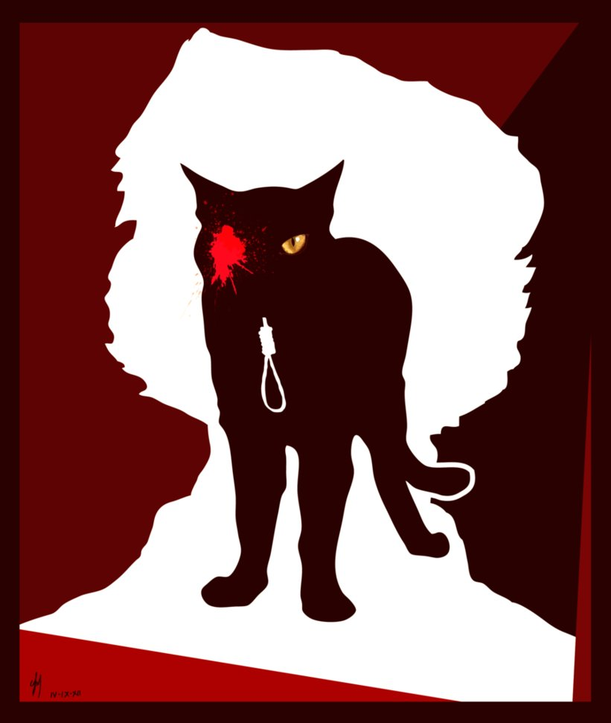
Let’s play a game…
The ending of Poe’s short story, “The Black Cat.”
Notes:
Situational- You don’t expect the cat to be in there.
20

Slide 21
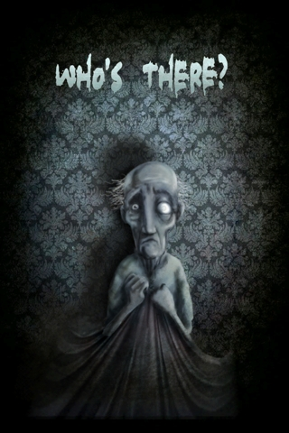
Let’s play a game…
The ending of Poe’s short story, “Tell-Tale Heart.”
Notes:
Situational- You don’t the narrator to rip up the floorboards and confess to the murder (and he was so close to getting away with it!).
21

Slide 22
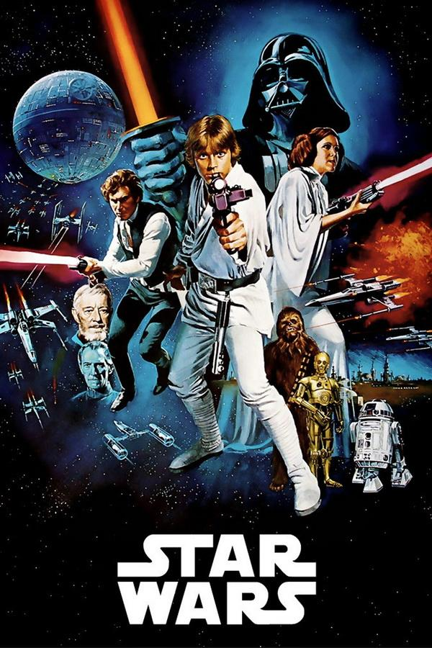
Let’s play a game…
In Star Wars, Luke doesn’t know that Darth Vader is his father until later in the series, but the audience knows sooner.
Notes:
Dramatic-The character doesn’t know that Darth is his father, but the audience does.
22

Slide 23
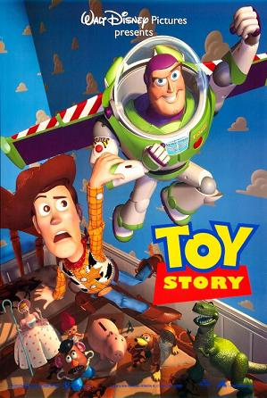
Let’s play a game…
In Toy Story, the toys move when the people are not there.
Notes:
Dramatic-The people don’t know the toys are real, but the audience does.
23

Slide 24
Let’s play a game…
Ricky was on a field trip at the museum all day. When he returned home, his grandmother asked how it was. Ricky replied, “I’d like to visit that museum again as much as I’d like to gnaw off my own foot!”
Notes:
Verbal-Ricky doesn’t actually mean he wants to chew his foot off. He just really disliked the museum.
24

Slide 25
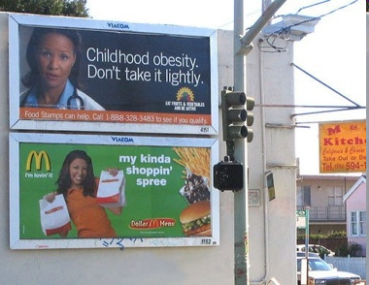
Let’s play a game…
Notes:
Situational- It’s ironic that a McDonald’s sign is beside a sign about obesity.
25

